Slide 1
Weakly-supervised Relation Extraction by Pattern-enhanced Embedding Learning
Advisor: Jia-Ling, Koh
Source: WWW 2018
Speaker: Ming-Chieh, Chiang
Date: 2018/12/25

Slide 2
Outline
Introduction
Method
Experiment
Conclusion

Slide 3
Motivation

Slide 4
Goal

Slide 5
Outline
Introduction
Method
Experiment
Conclusion

Slide 6
REPEL

Slide 7
Pattern Module
Reliability:

Slide 8
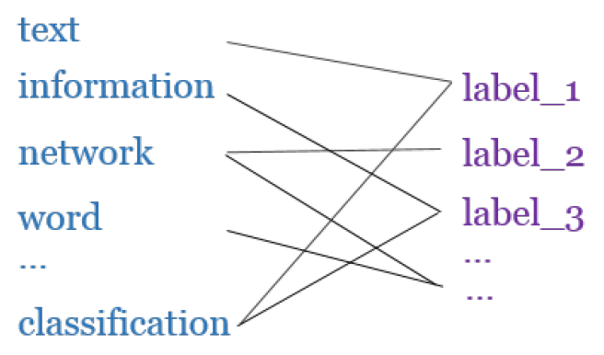
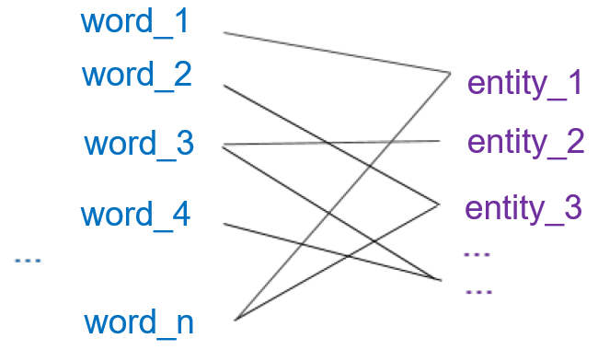
Distributional Module
Bipartite networks

Slide 9
Distributional Module
Conditional probability:
Objective function:
( KL-divergence )

Slide 10
Distributional Module
Score function of seed instances
–
–
–
‘
‘

Slide 11
Module Interaction
Co-training strategy

Slide 12
Joint Optimization Problem
Optimizing the Distributional Module
Optimizing the Pattern Module

Slide 13
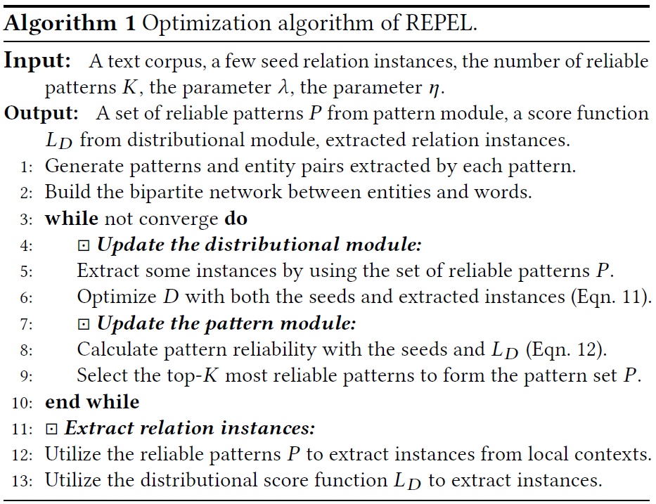
Joint Optimization Problem

Slide 14
Outline
Introduction
Method
Experiment
Conclusion

Slide 15
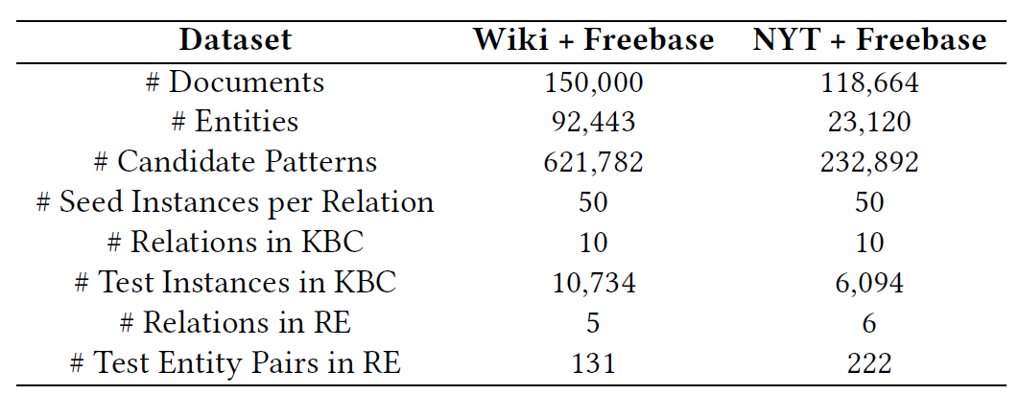
Datasets

Slide 16
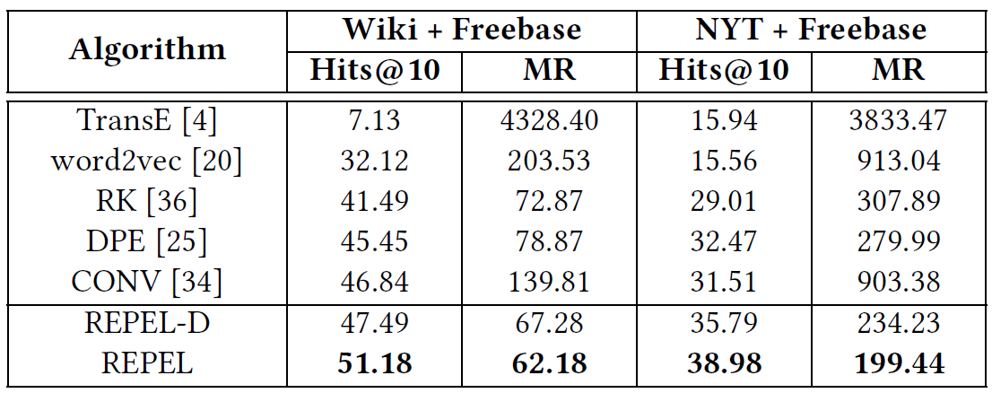
Knowledge Based Completion

Slide 17
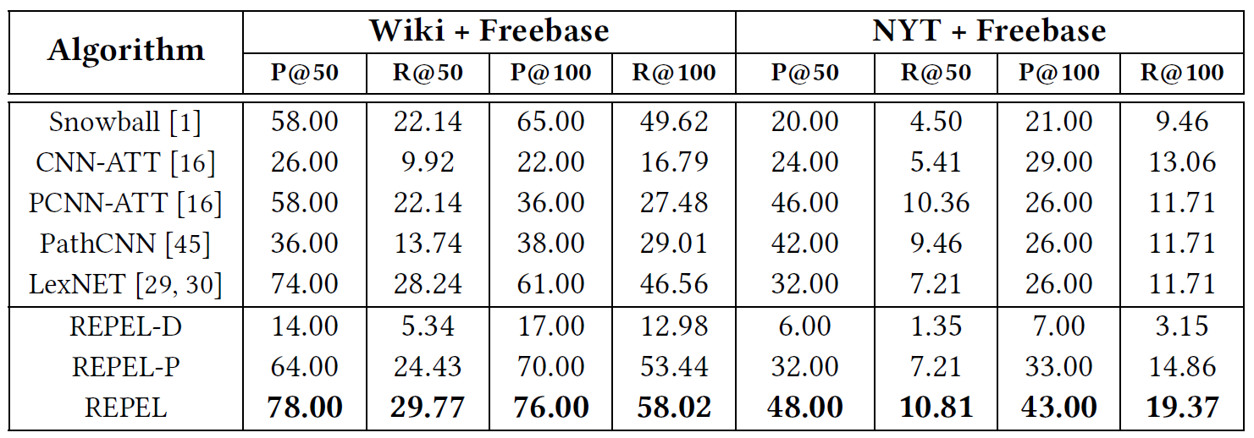
Corpus-level Relation Extraction

Slide 18
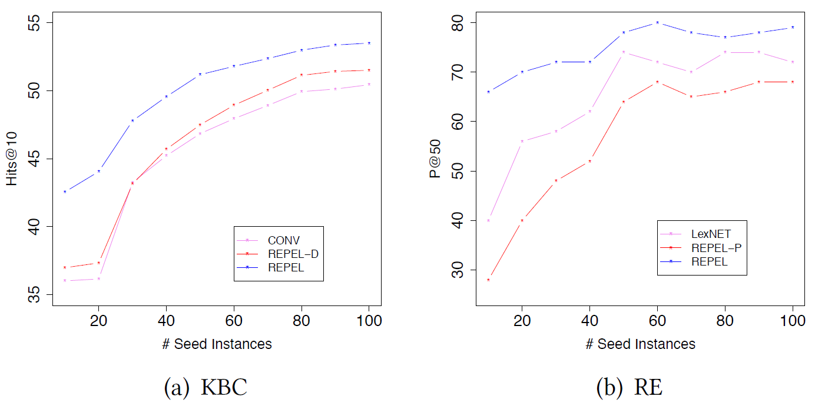
Performance Analysis

Slide 19
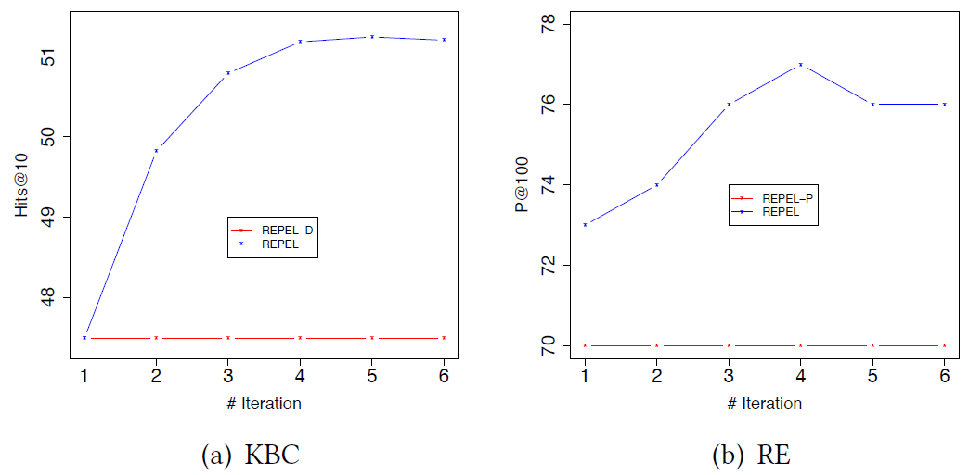
Performance Analysis

Slide 20
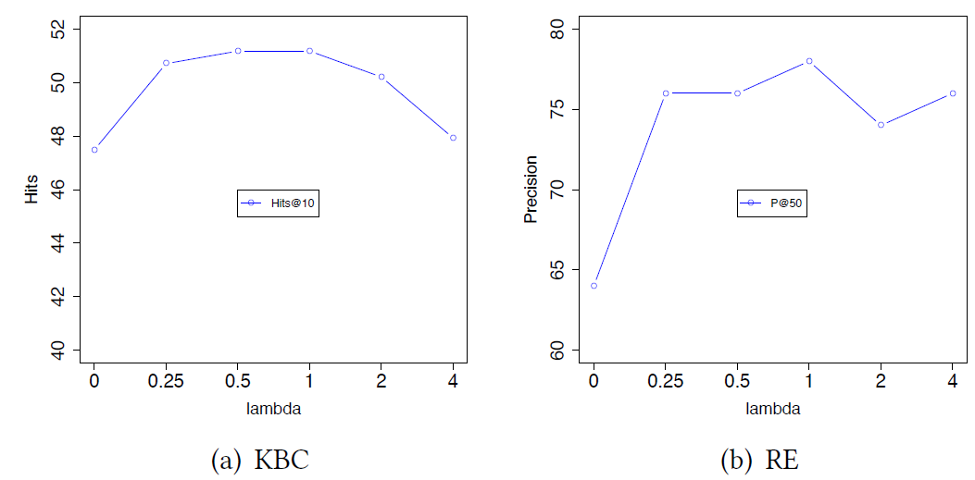
Performance Analysis

Slide 21
Outline
Introduction
Method
Experiment
Conclusion

Slide 22
Conclusion
We proposed a novel co-training framework called REPEL to integrate a pattern module and a distributional module

